Slide 1

New Frontiers of AI Explored in eCREAM
Bernardo Magnini (and the eCREAM Team)
Fondazione Bruno Kessler, Trento, Italy
magnini@fbk.eu
15 October 2026, Kosice

Slide 2
eCREAM NLP: Quick Recap
training
evaluation
DATA
MODEL
BENCHMARK
eCREAM model
Notes:
So we're going to combine these two ideas:

Slide 3
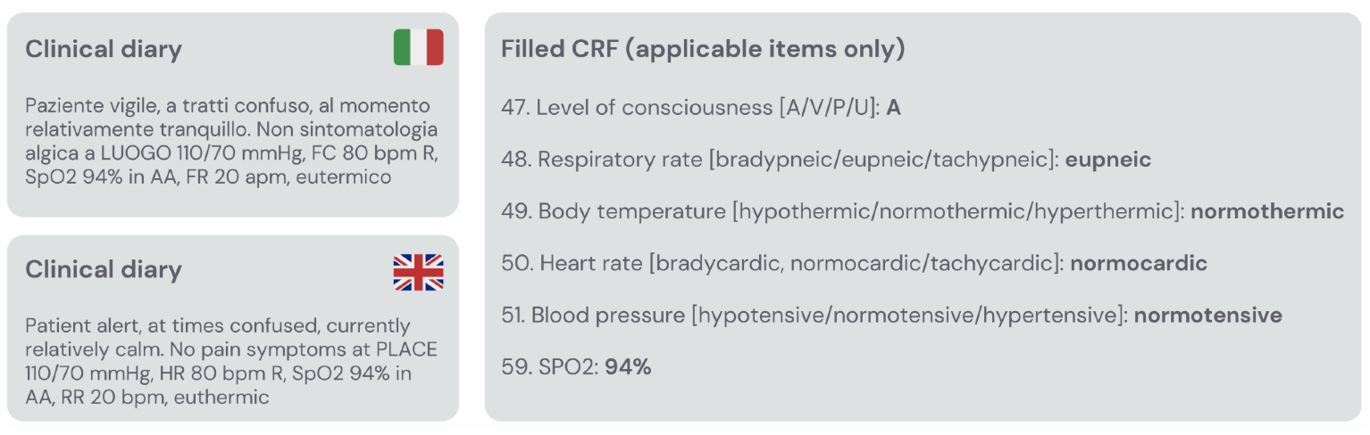
eCREAM NLP: Quick Recap
training
evaluation
DATA
MODEL
BENCHMARK
eCREAM model
ED clinical notes
Task: CRF-filling
Note+CRF
Notes:
So we're going to combine these two ideas:

Slide 4
eCREAM NLP: Requirements
training
evaluation
DATA
MODEL
BENCHMARK
eCREAM model
ED clinical notes
Task: CRF-filling
Note+CRF
High volume (millions) for training
Ideally, free data distribution for research purposes
High performance (accuracy)
Low cost
Open source
High quality
Reasonable volume (thousand)for testing
Ideally, free distribution for research purposes
Notes:
So we're going to combine these two ideas:

Slide 5
eCREAM NLP: Requirements
training
evaluation
DATA
MODEL
BENCHMARK
eCREAM model
ED clinical notes
Task: CRF-filling
Note+CRF
High volume (millions) for training
Free data distribution for research purposes
High performance (accuracy)
Low cost
Open source
High quality
Reasonable volume (thousand)for testing
Free distribution for research purposes
eCREAM set very ambitious goals!
Notes:
So we're going to combine these two ideas:

Slide 6
eCREAM NLP: Where we are
training
evaluation
DATA
MODEL
BENCHMARK
ED clinical notes
Task: CRF-filling
Note+CRF
Four (Astir?) Italian hospitals concluded the process
About 2M notes per hospital
eCREAM-medCorpus (advertised on scientific papers), no official release
Several experiments on small models (1B parameters): continual pre-training, fine tuning
MedGemma-27B currently best model on “gamma” benchmark
8K annotated notes+CRF
”Gamma” version for preliminary benchmarking is not satisfactory
MedGemma-27B currently best model on “gamma” benchmark
Notes:
So we're going to combine these two ideas:

Slide 7
eCREAM NLP: Where we are
training
evaluation
DATA
MODEL
BENCHMARK
ED clinical notes
Task: CRF-filling
Note+CRF
Four (Astir?) Italian hospitals concluded the process
About 2M notes per hospital
eCREAM-medCorpus (advertised on scientific papers), no official release
Several experiments on small models (1B parameters): continual pre-training, fine tuning
MedGemma-27B currently best model on “gamma” benchmark
8K annotated notes+CRF
”Gamma” version for preliminary benchmarking is not satisfactory
MedGemma-27B currently best model on “gamma” benchmark
Excellent work done so far, yet no single achievement!
Notes:
So we're going to combine these two ideas:

Slide 8
eCREAM NLP: Current Challenges
training
evaluation
DATA
MODEL
BENCHMARK
ED clinical notes
Task: CRF-filling
Note+CRF
Quality of Maize anonymization is low (several false negatives)
Apparently, no similar experience for data distribution in Italy/Europe!
No definite result for post-training of existing LLMs
Prompt self-refinement from errors: good results (submitted)
Take advantage of non-labeled data: Self-Relevance-Guided Masking (EMNLP 2026)
Quality of manual annotations so far is below expectations
Quality check is complex: need semi-automatic process
Notes:
So we're going to combine these two ideas:

Slide 9
eCREAM NLP: Current Challenges
training
evaluation
DATA
MODEL
BENCHMARK
ED clinical notes
Task: CRF-filling
Note+CRF
Quality of Maize anonymization is low (several false negatives)
Apparently, no similar experience for data distribution in Italy/Europe!
No definite result for post-training of existing LLMs
Prompt self-refinement from errors: good results (submitted)
Take advantage of non-labeled data: Self-Relevance-Guided Masking (EMNLP 2026)
Quality of manual annotations so far is below expectations
Quality check is complex: need semi-automatic process
Still fragmented results: need to be consolidated
Notes:
So we're going to combine these two ideas:

Slide 10
eCREAM NLP: Priorities
training
evaluation
DATA
MODEL
BENCHMARK
ED clinical notes
Task: CRF-filling
Note+CRF
Finalize eCREAM agreement for data distribution
Run post-processing on top of MAIZE (Pietro’s presentation)
Make available a MedGemma model for pilot internal data extraction
Collaboration with Apertus and Meditron 70B – Swiss.ai) for eCREAM post training
Revision of current “gamma” version (Guido’s presentation)
Add new annotated notes as new hospitals jump in
Notes:
So we're going to combine these two ideas:

Slide 11
eCREAM NLP: Priorities
training
evaluation
DATA
MODEL
BENCHMARK
ED clinical notes
Task: CRF-filling
Note+CRF
Finalize eCREAM agreement for data distribution
Run post-processing on top of MAIZE (Pietro’s presentation)
Make available a MedGemma model for pilot internal data extraction
Collaboration with Apertus and Meditron 70B – Swiss.ai) for eCREAM post training
Revision of current “gamma” version (Guido’s presentation)
Add new annotated notes as new hospitals jump in
We need a short-term agenda!
Notes:
So we're going to combine these two ideas:

